Slide 1

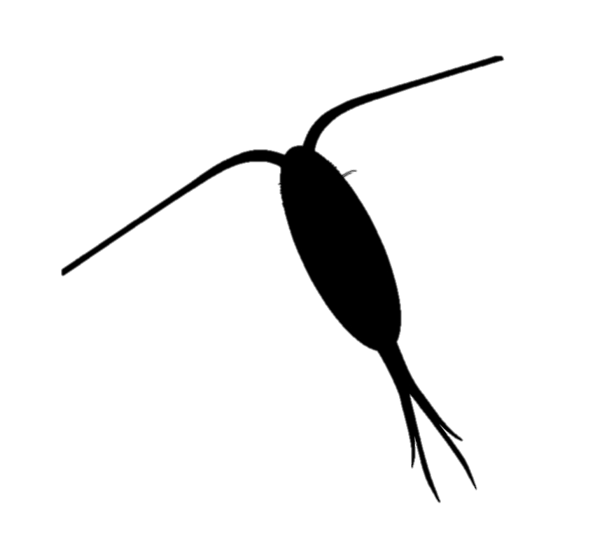


A)
O₂
B)
CO₂
Atmosphere
Gas-exchange
Gas-exchange
Ebullition
Equilibration
O₂
DIC
CO₂
NO₃⁻ assimilation
Respiration
Respiration
Photosynthesis
Photosynthesis
Water Column
Photorespiration
Photorespiration
Captive bubbles
Benthos

